Slide 1


Presented by : Fares Shereif Ismail
Code : 22011586
Final Training Project Report

Slide 2
Overview
This project analyzes the UCI Student Performance dataset
(Portuguese subset, 649 records) to predict grades and identify at-risk students.
Key Focus: Data prep, EDA, visualizations, K-Means clustering, supervised models (e.g., Random Forest), and recommendations.
Outcomes: Models achieve 92% F1 with prior grades clusters reveal Dedicated, Social, At-Risk personas.
Value: Early interventions could boost pass rates by 15-20%.
Data Prep
EDA
MODELS
Insights

Slide 3
Problem Statement
and Value
Problem: Schools often react late to student struggles, leading to higher dropouts and wasted resources.
Dataset Opportunity: Use UCI data
(demographics, study habits, grades) to predict outcomes early.
Value Proposition: Predictive models identify at-risk students high absences triple failure odds.
Broader Impact: Supports UN SDG 4 (Quality Education)
potential 15-20% pass rate improvement via targeted support.

Slide 4
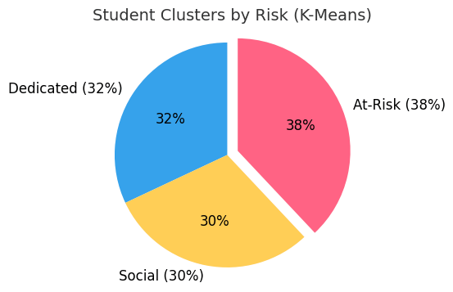
This pie chart illustrates the K-Means clustering of 649 students into three groups based on study habits and support: 'Dedicated' (32%) with high study time and low absences (G3 ~13.2), 'Social' (30%) with moderate study and social activity (G3 ~11.5), and 'At-Risk' (38%) with low study time and high absences
(G3 ~10.1). The 38% At-Risk group highlights the need for early interventions, potentially boosting pass rates by 15-20% through targeted support.

Slide 5
Dataset Description
Source: UCI ML Repository (ID 320), CC BY 4.0 License Portuguese course subset (649 rows, 33 columns).
Features: Binary (5, e.g., schoolsup), Categorical (7, e.g., Mjob), Ordinal (5, e.g., studytime), Numeric (13, e.g., age, absences).
Grades: G1, G2, G3 (0-20 scale).
Stats: Avg. Age 16.74 Avg. Absences 3.51 Avg. G3 11.91 (SD 3.23).

Slide 6
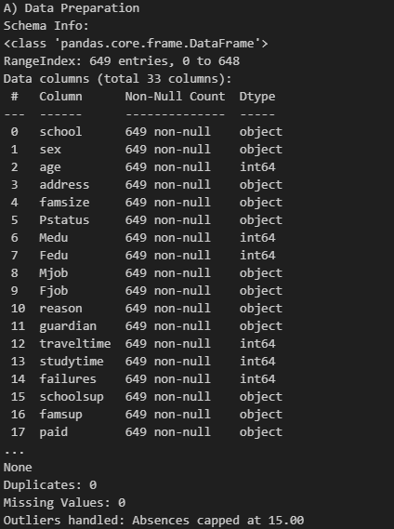
Quality: No duplicates/missing outliers capped (absences at 15).

Slide 7
Methods Overview
Tools: Python (pandas, scikit-learn, matplotlib) ucimlrepo for data loading.
Pipeline: Data Quality/Prep (Task A) → Transformation (Task B) →
EDA (Task C) → Visualization (Task D) → K-Means (Task E)
→ Supervised Models (Task F) → Evaluation (Task G) → Insights (Task H).
Variants: With/Without G1/G2 (to handle leakage).
Evaluation: Accuracy, F1, AUC GridSearchCV for tuning.

Slide 8
Data Preparation and Transformation (Tasks A & B)
Quality Checks: No duplicates/missing outliers handled
(IQR winsorization on absences).
Transformations: One-hot encoding (categorical, e.g., sex)
Standard scaling (numeric, e.g., age).
New Features: Attendance_proxy (absences <10), Pass (G3 >=10),
Risk (high/medium/low).
Variants: With G1/G2 (leakage, high accuracy)
Without (early prediction).

Slide 9
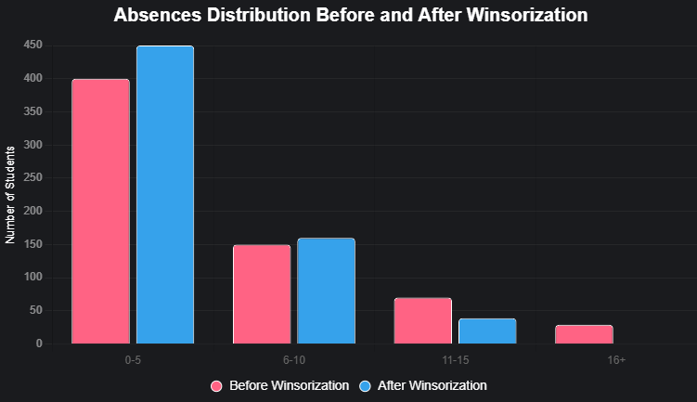

Slide 10
Exploratory Data Analysis (Task C)
Key Stats: Correlations (G1/G2 strong positive failures -0.39 negative).
Group Insights: No failures → G3=12.5 2+ failures → G3=8.8.
Hypotheses : More study time → higher G3 Urban > Rural (12.3 vs. 11.1) Romantic/alcohol minor drops.
Takeaway: Failures and absences are top risk factors.

Slide 11
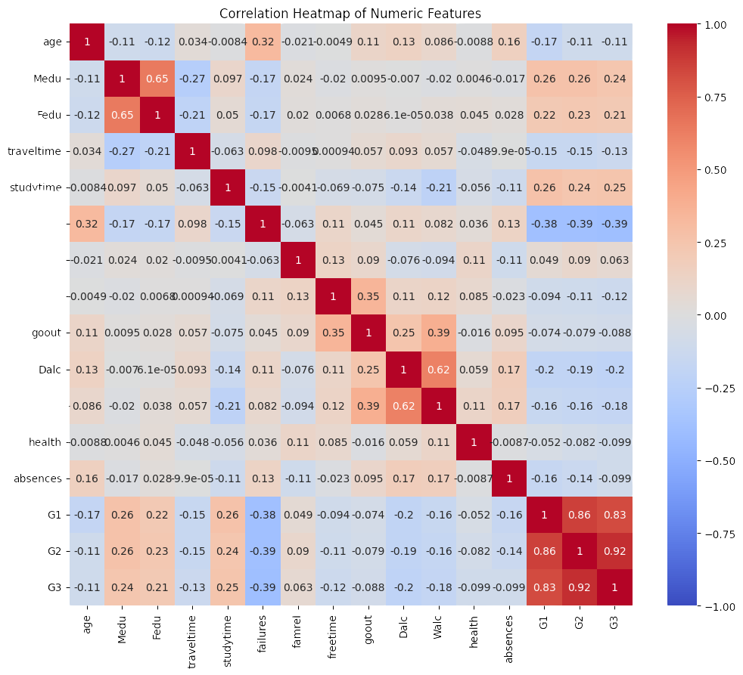

Slide 12
Visualizations (Task D)
Distributions: Age (16-18 peak), Absences (0-2 common),
Studytime (2-5 hrs most).
Relationships: Study time ↑ → G3 ↑
Absences vs. G3 (r=-0.10, weak negative).
Comparisons: G3 by failures
(boxplot: more failures → lower G3) Schoolsup "yes" → lower G3 (selection bias).
Interpretation: Lifestyle factors minor prior performance dominates.

Slide 13
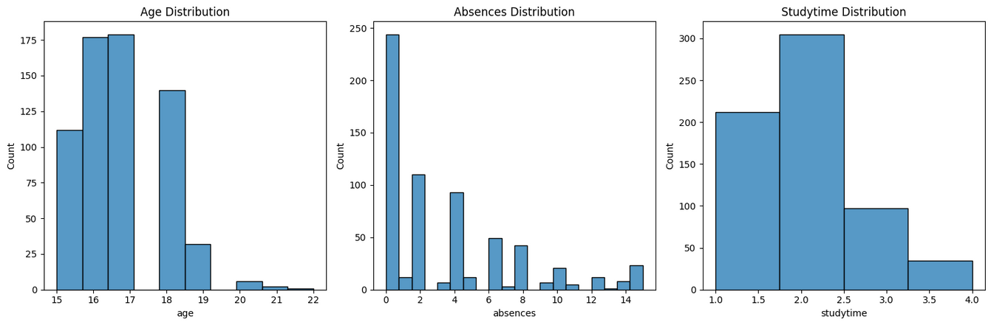
Age Distribution: Most students are between 16 and 18 years old, with the majority
being 16 or 17. Very few
students are older than 19, which reflects the typical age range of secondary school students.
Absences Distribution: The majority of students have very few absences
(between 0 and 2 days), but there are
some cases with higher absence counts, though these are much less common. This indicates that while most
students attend regularly, a small group is frequently absent.
Study Time Distribution: Most students report studying between 2 to 5 hours per week (category 2), followed
by those who study less than 2 hours (category 1). Fewer students study more than
5 hours per week
(categories 3 and 4). This shows that intensive study time is relatively rare in the dataset.

Slide 14
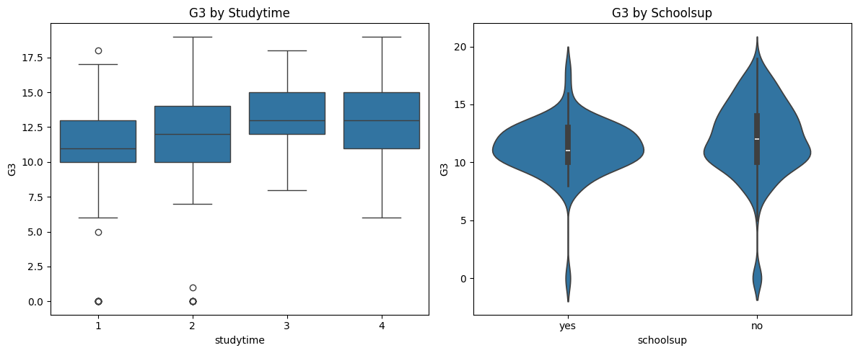
1. G3 by Studytime (Boxplot)
This plot shows the relationship between study time and final grades (G3).
As study time increases from category 1 to 4, the median G3 also increases.
This indicates that students who dedicate more hours to studying tend to achieve higher
grades.
Outliers at the lower end suggest that some students still perform poorly despite studying.
2. G3 by Schoolsup (Violin plot)
This plot compares students’ grades based on whether they received school support
(schoolsup).
Students without school support (“no”) generally have slightly higher grades than those with
support (“yes”).
This does not necessarily mean that support lowers performance rather, it likely reflects
that school support is provided mainly to weaker students who were already struggling.

Slide 15
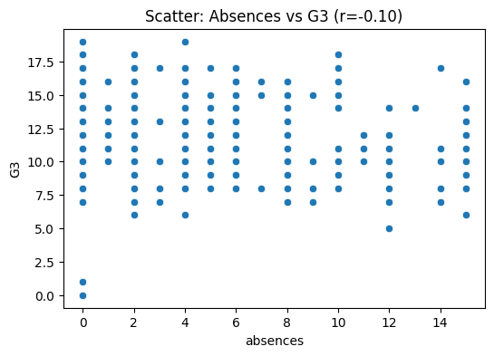
This scatter plot shows the relationship between student absences (x-axis) and G3 scores
(y-axis), with a correlation coefficient of r = -0.10.

Slide 16
Unsupervised Learning
K-Means (Task E)
Features Used: Studytime, absences, goout, freetime, famsup, schoolsup.
Optimal K=3 (Elbow + Silhouette score ~0.21).
Clusters:
Dedicated (32%): High study, low absences G3=13.2, 90% pass.
Social (30%): Moderate study, high social G3=11.5, 75% pass.
At-Risk (38%): Low study, high absences G3=10.1, 60% pass.
Implication: Target At-Risk for interventions.

Slide 17
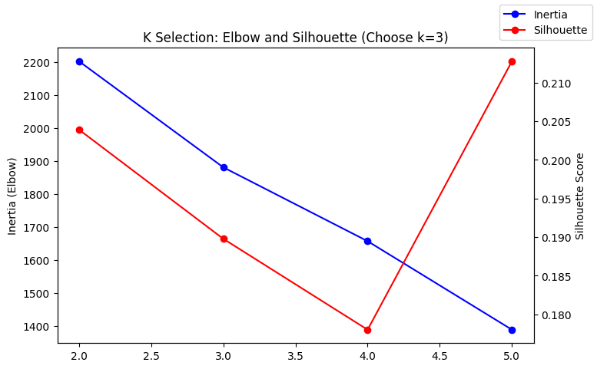
Unsupervised Learning
K-Means (Task E)

Slide 18
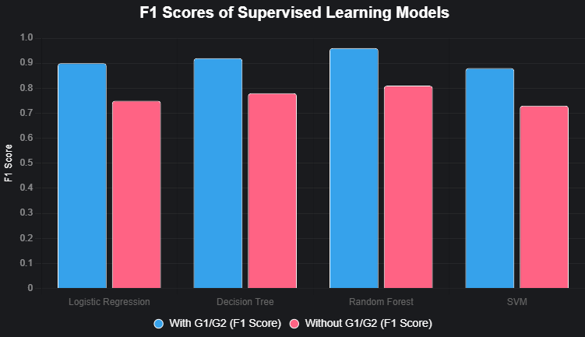
Supervised Learning (Task F)
Targets : Binary (pass/fail) Multi-class (high/medium/low risk).
Models : Logistic Regression, Decision Tree, Random Forest, SVM.
Setup : 80/20 train/test split GridSearchCV
(RF: n_estimators=100, max_depth=5).
Variants : With G1/G2 (96% F1 RF) Without (81% F1 RF).

Slide 19
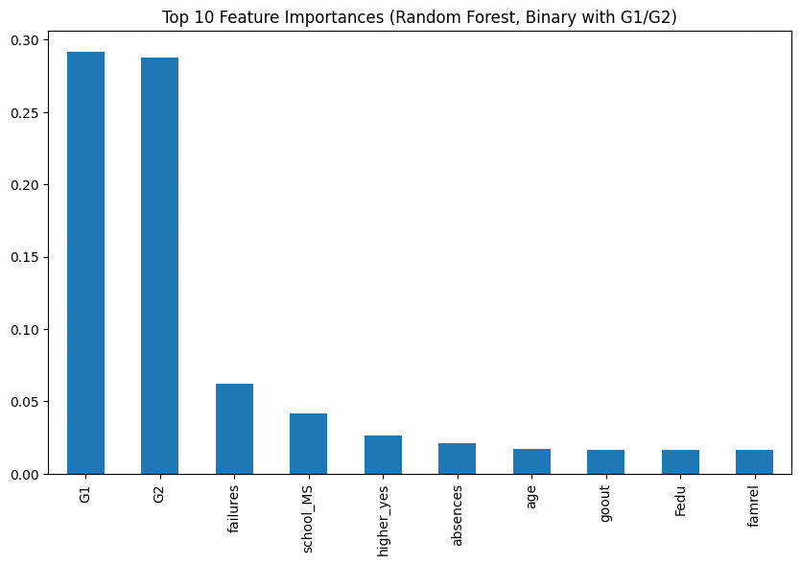
Model Evaluation & Comparison (Task G)
Metrics: Binary (F1 0.96 with G1/G2 0.81 without)
Multi-class (F1 0.85/0.65).
CV: Low variance (<0.05), no over/under-fitting.
Feature Importances: G1/G2 dominate (0.29 each) Without: Failures, absences, studytime key.
Comparison: Leakage boosts 15-20% No-leakage for early use.

Slide 20
Insights and Recommendations (Task H)
Insights: Failures triple odds Clusters guide personas Urban-rural gap 1.2 points.
Recommendations: Attendance tracking, study workshops, family programs Target At-Risk (38%) for 15-20% pass boost.
Storytelling: From data cleaning to models → Proactive education equity.

Slide 21
Ethics, Limitations, and Conclusion
Ethics: Privacy (anonymize data) Bias/Fairness
(audit for rural/sex bias) Transparency (use SHAP).
Limitations: Small sample (649) Leakage risk Portugal-specific Self-reported bias.
Conclusion: ML enhances interventions Future: Larger datasets, causal analysis.
Reproducibility: pip install requirements Run notebook.

